Slide 1
System and Network Administration
Introduction & Overview

Slide 2
A Philosophy
System Administration is about
Putting together a network of computers
Getting them to run some applications
Keeping them running in a dynamic world
System Administration is as much about technology as it is about user behaviour
System Administration requires constant monitoring and rapid response to problems

Slide 3
Network & System Administration
Put together a network of computers
Get them running
Keep them running (despite Users….)
Provide a Service to Users
Requires skills of
Mechanic
Sociologist
Researcher
Notes:
FIT2018 Network Admin - Role of Network Administrator
26/02/2022
FIT2018 (c) Monash University
3

Slide 4
Challenges
Deploy and update many machines
Understand how services support business tasks
Plan and implement adequate security
Be able to fix errors and problems
Keep track of and be able to use knowledge
Provide comfortable environment for users
Notes:
This is more than just about installing computers and networks
planning and
designing
an efficient community of computers that allow users to get their jobs done.
Designing logical, efficient networks
Deploying and updating many machines
Deciding what servers are needed, and limits thereof
Plan and implement security
Give users an environment that they need to be productive and comfortable
Troubleshooting: detecting and fixing errors
Keep track of new technology and knowledge
FIT2018 Network Admin - Role of Network Administrator
26/02/2022
FIT2018 (c) Monash University
4

Slide 5
Systems & Network Administrator Skills
Unix/Windows usage, installation, configuration
Shell utilities and script programming
C and how to use make
Network: TCP/IP, Ethernet, hardware
Infrastructure services: DNS, DHCP
Shared storage: NFS, CIFS
Directory services: LDAP, Active Directory, NIS
User services: web, mail, database, groupware
System tuning and accounting
Security consciousness
Notes:
It’s a sad state of affairs that Unix provides a tougher interface to get used to.
But Windows has a long way to go in many ways:
Performance
Security
Flexibility and portability
It is possible, of course, to run a network of Windows servers.
But Unix servers (Solaris, Linux, FreeBSD) are considered to be better, in general.
Building packages from source (C programs) is generally desirable.
Of course, Novell Netware should not be ignored.
FIT2018 Network Admin - Role of Network Administrator
26/02/2022
FIT2018 (c) Monash University
5

Slide 6
Outcomes
Successful completion of this module means you will be able to:
Explain the role and operation of each of the software components essential to a corporate networked information system
Evaluate proposed improvements to the configuration of a corporate networked information system and the associated administration policies and procedures
Integrate DNS, DHCP, email, web, LDAP, and SSL to create a working system
Combine new elements into the basic system to meet the needs of diverse communities of interest

Slide 7




Slide 8
Theme: Virtualization
One physical machine running a host OS, with one or more virtual machines running a possibly different guest operating system
Example:
Hardware: blade server, 64-core Intel, 64 GB RAM
OS: Red Hat Enterprise Linux
Virtualization Platform: Xen
Virtual machines: 32 configured as a cluster
This is the main idea
of Cloud Computing
Lower cost of ownership
labor costs
capital expenditure
power consumption
rack space

Slide 9
Virtual Networking
Physical
Network
Interface
VirtualBox Environment
Logical
Interface
Device
Driver
VM
Logical
Interface
Logical
Interface
VM
Host Operating
System
Logical
Interface
Virtual
Hub
VM
Built-in DHCP
Built-in NAT

Slide 10
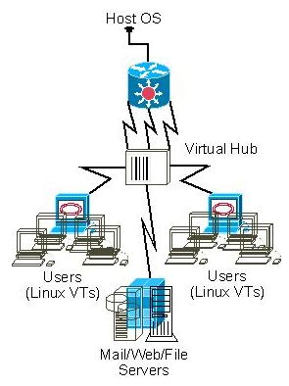
VirtualBox “Virtual Physical” Architecture
Real subnets with real software, virtual wiring
Can we actually say that?
Think of it this way:
Would you expect to be able to paste what you copied if you had
to change chairs to be in front of the screen, mouse, and keyboard?
That is what virtual means:
It acts like a real, separate machine but it runs in a window
How Nice Is That ... real systems with virtual hardware (VTs) and virtual connections (wires)

Slide 11
TinyNet: Virtualization
Philosophy:
One service, one server
Minimal server footprint – 128mb RAM, 200mb storage
- run a 4-5 node network on a 4gb RAM Windows host
- store everything on a 2gb thumbdrive
Open source, easy to replicate and configure
- (Sun) VirtualBox
- Standard linux distribution: Slackware
Tool for learning and understanding
- curses interface, de-referenced scripts
- buggy pre-configuration to provide good examples

Slide 12
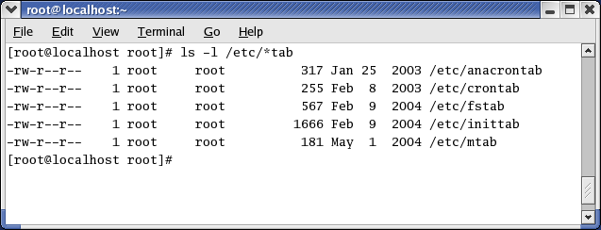
Because of Linux’s UNIX roots, the primary method by which it is administered is the command line.
Commands are often followed by switches, which allow different options to be used.
All administrative tasks can be performed from the command line, either by issuing specific commands or editing text-based Scripts written to automate tasks. configuration files.

Slide 13
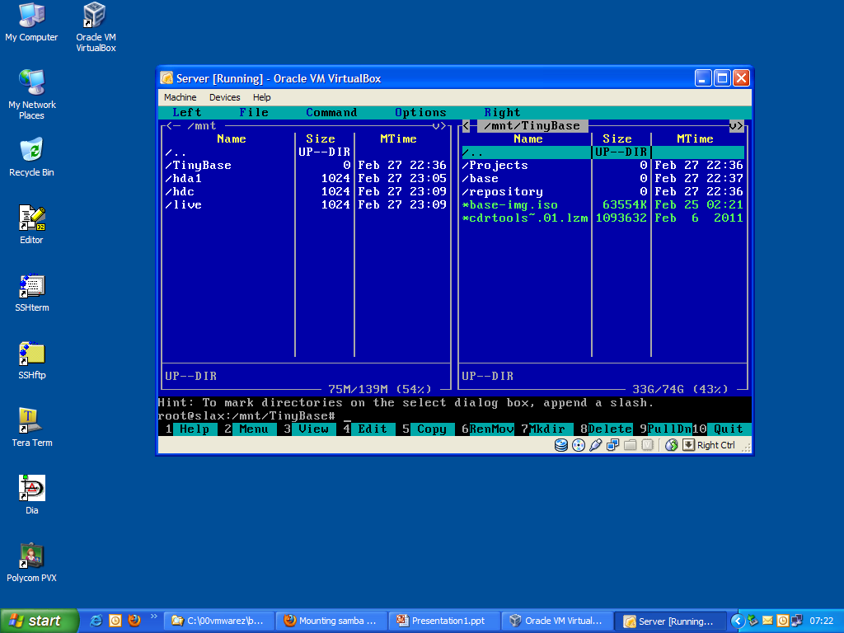
Most Linux distributions have GUI configuration utilities as well.
These are usually just a thin layer of interpreted code that calls the command line script
We strike a balance with utilities that have a user interface built on the curses libraries
This will get to be familiar
VM running the mc file manager –
One of the greatest linux utilities ever!

Slide 15
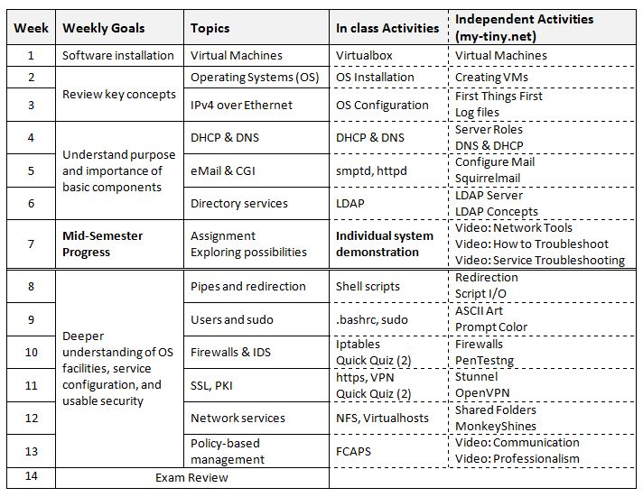

Slide 16
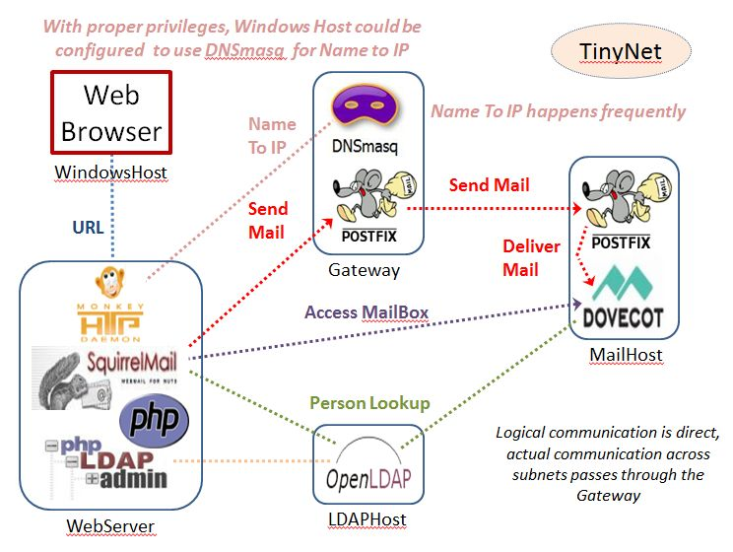
TinyNet: base configuration
Everything is built on a generic image
Pre-configuration is limited to what is necessary to overcome some environmental oddities
software is packaged to meet dependencies, ease installation

Slide 17
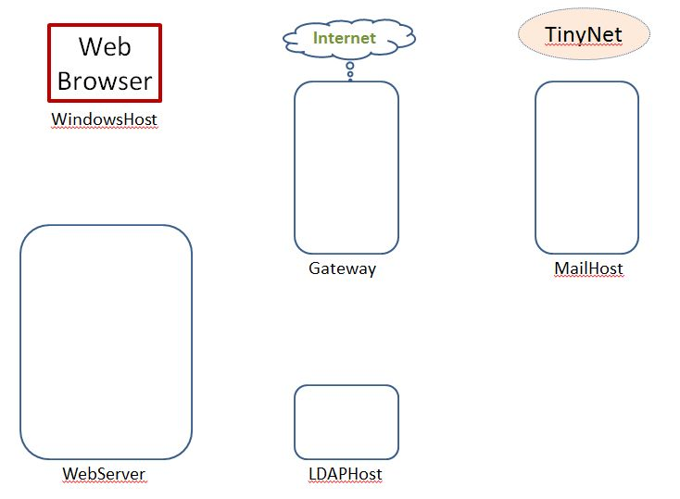
Getting Started
TinyNet
Comes in two parts
Base.iso (base image)
Config.iso (configuration and applications)
After installing
VirtualBox,
create VMs!
www.my-tiny.net
Create one virtual machine
Partition the disk
Create a filesystem
Copy the OS
Install the bootloader

Slide 18
Clone VMs
Configure common services
Clone!

Slide 19
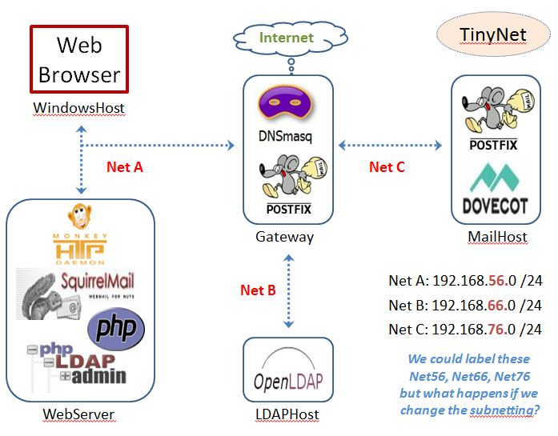
Configure Roles

Slide 20
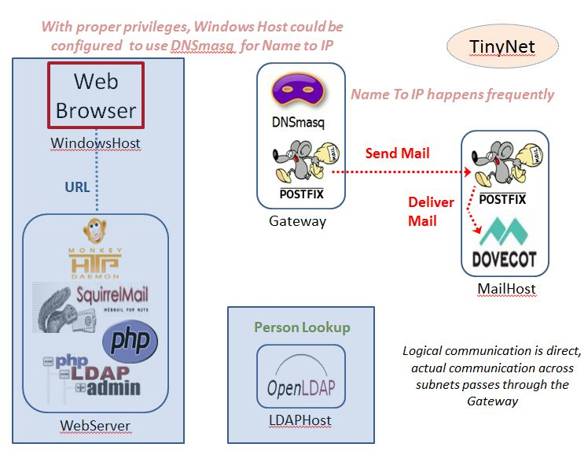
Configure Mail

Slide 21
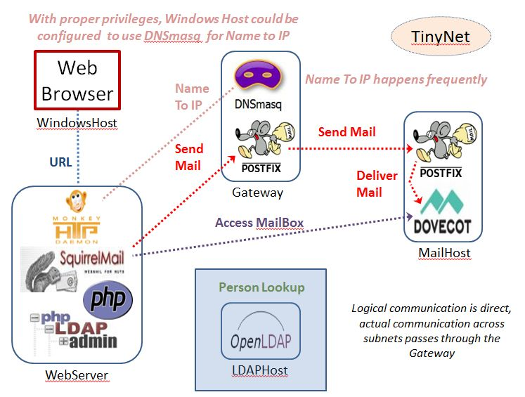
Configure Webmail

Slide 22
Configure LDAP

Slide 24
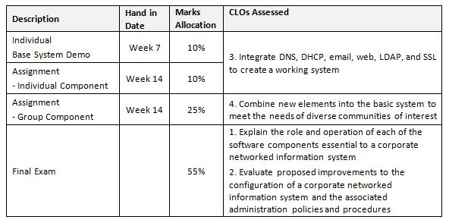
Assessment

Slide 25
Theme: Problem Solving
Having detected the fault or Problem
Isolate the problem and identify/define it
Use tests and tools to diagnose the problem
Solve the problem and document the solution
Prioritize multiple problems
Requires skills of
Mechanic
Sociologist
Researcher
Notes:
FIT2018 Network Admin - Role of Network Administrator
26/02/2022
FIT2018 (c) Monash University
25

Slide 26
Transferable skills
Know what you want, discover how
Being methodical, especially with troubleshooting
Lifelong learning – search and discover, don’t be intimidated
Cultural sensitivity – people do the same thing in different ways
Requires skills of
Mechanic
Sociologist
Researcher

Slide 27
Resources
Best General Linux Reference
RedHat 9 Guides - www.my-tiny.net
Close to our distribution – but different!
(our distribution is small, but has all the capabilities we need)
Be careful looking at documentation, instructions, configurations: they are different for different distributions
As you get familiar with what we have, you will be able to identify these differences and adapt
Celebrate
Diversity!

Slide 28
Good Tech Support Requires Good Info
Start Menu - Windows Admin Tools - System Info
Highlight one line, then Edit - Copy
or File - Export and open the .txt file
from the top
OS Name
Version
System Model
Processor
at the bottom
Virtualisation-based security
Hyper-V - Virtualization Enabled in Firmware
VirtualBox – Help – About
Version

Slide 30
Layers of Complex Software
Any complete OS (Win, OSX, Linux,…)
VM (Guest OS)
Device Drivers
Virtual Devices
First step:
Making sure all of these components are ready to work together …
Other
Apps
VirtualBox
or Vmware, Docker, Android Studio, …
(Level 2 Hypervisor)
Virtual Drivers
Windows (Host OS)
Hyper-V
Win OS runs as a VM
(Level 1 Hypervisor)
Device Drivers
--- --- --- Hardware --- --- ---
Trusted Platform Module (TPM)
CPU
-----------
HW Virt
Memory
,,, I/O Devices ,,,
BIOS
Core allocation
Memory isolation

Slide 31
Layers of Complex Software
“Level 2 Hypervisor”
Apps
A “Level 1 Hypervisor” essentially takes full control of the device drivers and makes the Host OS run as a virtual machine
Windows (Host OS)
Hyper-V
Win OS runs as a VM
(Level 1 Hypervisor)
Device Drivers
--- --- --- Hardware --- --- ---
Windows 10 has optional “virtualization-based security” features that will be mandatory in Windows 11
Trusted Platform Module (TPM)
CPU
-----------
HW Virt
Memory
,,, I/O Devices ,,,
BIOS
Core allocation
Memory isolation
When we stack a “Level 2” hypervisor on top of a “Level 1” we have “Nested Virtualization”

Slide 32
Layers of Complex Software
Any complete OS (Win, OSX, Linux,…)
VM (Guest OS)
Device Drivers
Virtual Devices
Other
Apps
VirtualBox
or Vmware, Docker, Android Studio, …
(Level 2 Hypervisor)
Virtual Drivers
Windows (Host OS)
Required for Win 11
Optional for other versions
Hyper-V
Win OS runs as a VM
(Level 1 Hypervisor)
Device Drivers
--- --- --- Hardware --- --- ---
Required for Win 11
Trusted Platform Module (TPM)
CPU
-----------
HW Virt
Memory
,,, I/O Devices ,,,
Required for Hyper-V
BIOS
Core allocation
Memory isolation

Slide 33
Nested Virtualization
A Level 2 hypervisor is an application running inside an existing OS, while a Level 1 hypervisor is in effect the OS itself.
This means that when you enable Hyper-V, your Windows 10 "host" becomes a virtual machine.
A special one, but nonetheless a virtual machine.
Hyper-V is the same on Win10 Home, except the ability to run Hyper-V virtual machines is disabled.
With the host OS as a VM, it has exclusive access to the hardware virtualization features of the CPU - the Intel VT-X or AMD-V instructions are not accessible to third-party software.

Slide 34
Nested Virtualization
Microsoft chose not to expose these instruction to the "guest" systems, which caused problems with (for example) the Android device emulator used by Android Studio and Microsoft Visual Studio, Docker, VMware, VirtualBox, and eventually the Windows Subsystem for Linux (WSL2) in Win10 itself!
Bottom line: Microsoft forced themselves to reconsider, but since they started late, there are certain combinations of Win10 versions and processors (especially Intel CPUs) where Hyper-V and Win10 "features" that depend on it must be switched off for guest systems to run.
There are many kilometers of forum posts about these problems and their fixes, but the latest versions of Virtualbox 6.2 are recognised as working well

Slide 36
Layers of Complex Software
VM (Guest OS)
Device Drivers
Virtual Devices
Other
Apps
VirtualBox
Virtual Drivers
Windows (Host OS)
Hyper-V
Device Drivers
--- --- --- Hardware --- --- ---
Trusted Platform Module (TPM)
CPU
-----------
HW Virt
Memory
,,, I/O Devices ,,,
BIOS

